Slide 1
Modeling Sleep Related Physiological Response Variables
Samuel Kwon

Slide 2
Background
Reference Paper: SaYoPillow: Blockchain Integrated Privacy Assured IoMT Framework for Stress Management Considering Sleeping Habits
E-Textile pillow that measures sleep and physiological variables.
hours of sleep, snoring range (dB), respiration rate (bpm), heart rate (bpm), blood oxygen levels, eye movement rate (REM), limb movement rate, body temperature, and stress state
Generated data will be utilized for machine learning to determine stress level.
Experimental data

Slide 3
Goal and Methods
Explore dataset given and the nine measured variables
Explore relationships between physiological variables
Generate a linear regression model for respiration rate
Question: How does sleep related physiological variables relate to each other?
Methods:
Criterion Based Selection Methods: AIC and BIC
Multicollinearity: VIF and Condition Constant
Linear regression model summary: Exploration of p-values

Slide 4
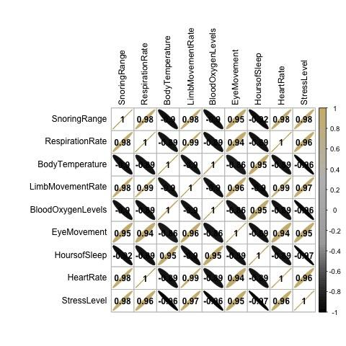
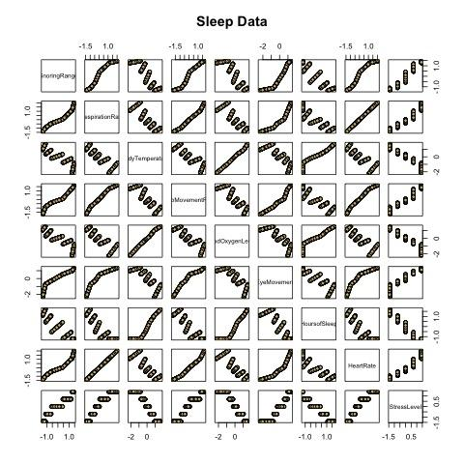
Initial Data Exploration
Stress is a discrete variable
hours of sleep, snoring range (dB), respiration rate (bpm), heart rate (bpm), blood oxygen levels, eye movement rate (REM), limb movement rate, and body temperature are continuous variables
Nonlinearity present between some variables.
Stress is discontinuous (Step Function)
Negative correlations present between some variables
Initial Attempt (General Linear Model)
Poisson Regression and Binomial Regression
Errors present cause of variable property

Slide 5
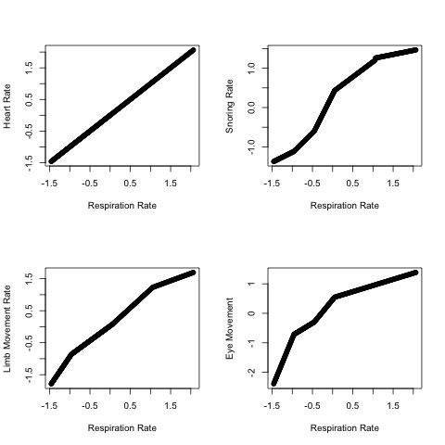
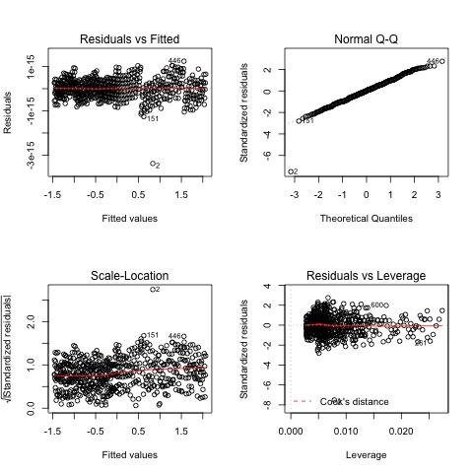
Respiration Model
Normalized dataset
Four predictors taken into consideration: Heart Rate, Eye Movement, Limb Movement Rate, and Snoring Range
Linear Regression Assumptions
Linearity: Residuals V Fitted Plot
Independence: Durbin Watson Test (p value=0.234) thus no correlations present
Normality: QQ Plot
Constant Variance: Residuals V Fitted Plot
General Model Summary
P-value of limb movement rate and snoring rate are greater than 0.05

Slide 6
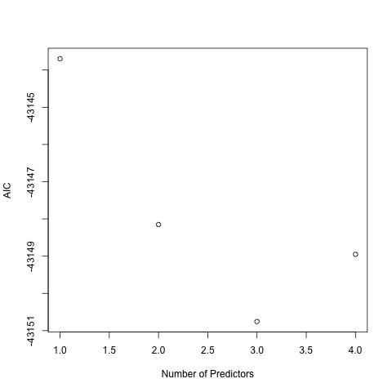
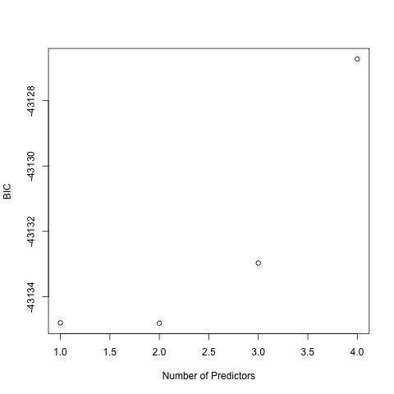
Criterion Based Methods: AIC and BIC
AIC
Should use three predictors. They are heart rate, limb movement rate, eye movement.
P-value for limb movement rate is greater than 0.05
BIC
Should use two predictors. They are heart rate and limb movement rate.
P value for limb movement rate is greater than 0.05
Both models are insignificant and rely on limited variables.

Slide 7
Multicollinearity: VIF and Condition Number
VIF
VIF for heart rate is 105.92, the snoring range is 28.44, the limb movement rate is 183.05, and the eye movement rate is 24.86
Condition Number (kappa)
Constant kappa is 25.60
AIC Adjusted and BIC Adjusted Models both have similar VIF and Kappa values.

Slide 8
Final Model
Final model will have two predictors. They are heart rate and eye movement.
Eye movement p-value is less than 0.05
VIF for heart rate is 8.01 and for eye movement is 8.01
Constant kappa is 5.52
Heavy reliance on heart rate (shown by strong linear relationship in pairs plot)

Slide 9
Conclusion and Discussion
Multicollinearity still present
Heart rate and eye movement can be linear combinations of each other
Model states an error: Regression fit is perfect and summary might be inaccurate
Clear that all variables utilized in this model have some type of relationship.
Heart rate is a significant physiological variable that controls the body's response during sleep, it would be safe to say that the heart rate impacts eye movement, limb movement, and snoring range.
Importance of thinking about how the variables might be related before performing linear regression
Exploring and generating a model for stress.
Generate a stress variable that is not discrete but continuous.
Non parametric methods of modeling: Additive Modeling

Slide 10
Thank You
For any questions, please email
samkwon150@gmail.com

